Slide 1
FraudFinder Case Study
Assessment of the US FraudFinder Business
By Hemal Dandwani
Date: June 10, 2024

Slide 2
Indf,vmIds
Introduction
Overview of FraudFinder FraudFinder is a software application designed to help businesses mitigate risks by screening individuals and entities against various risk factors such as previous criminal activity, bankruptcy, and political sensitivity. Versions:
FraudFinder: Original version with a long presence in the US market.
FraudFinder 2.0: Released 5 years ago with an improved interface and additional functionalities.
Business Model: Both versions charge an annual subscription fee based on the company's size. For the past three years, a 10% annual price increase has been applied to all customer accounts at renewal.

Slide 3
Problem statement
Objective of the Case Study :
Objective of the Study
To assess the health of the US Fraud Finder business and determine the optimality of the current business model for potential international expansion.
Key Questions :
How well is Fraud Finder performing in the US market?
Are there areas for improvement in the business model?

Slide 4
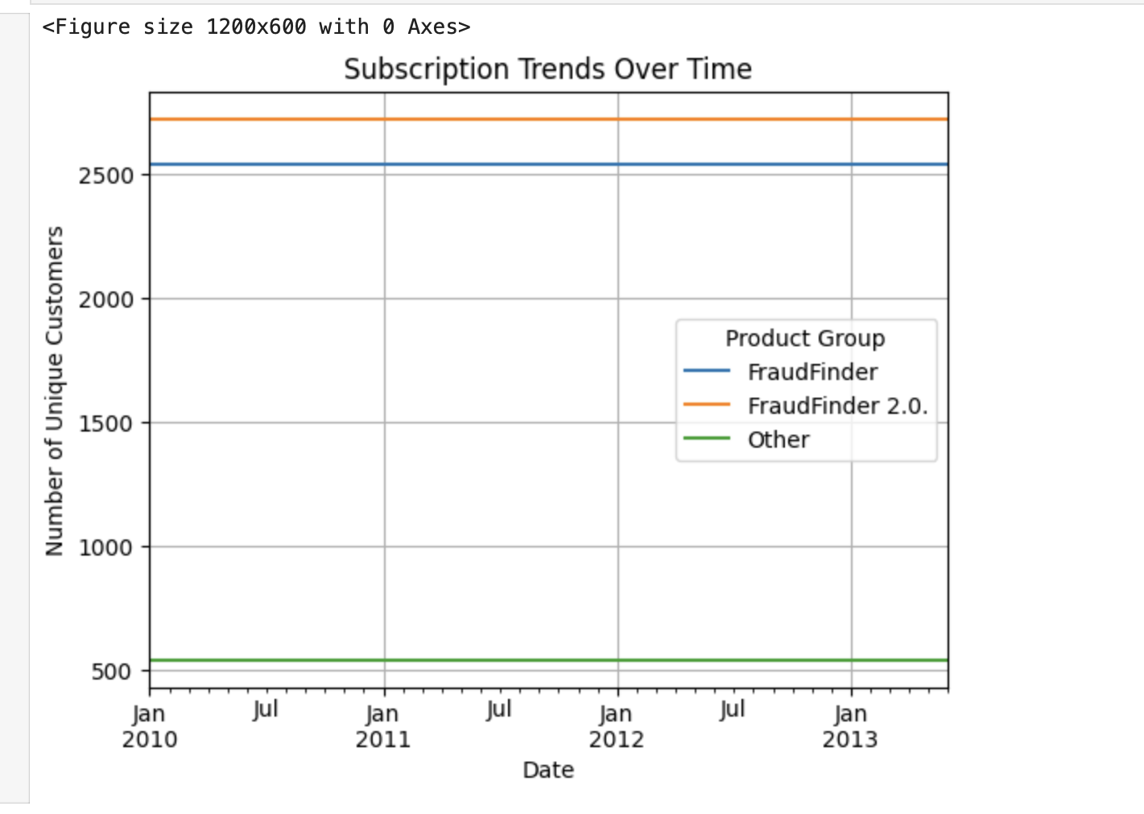
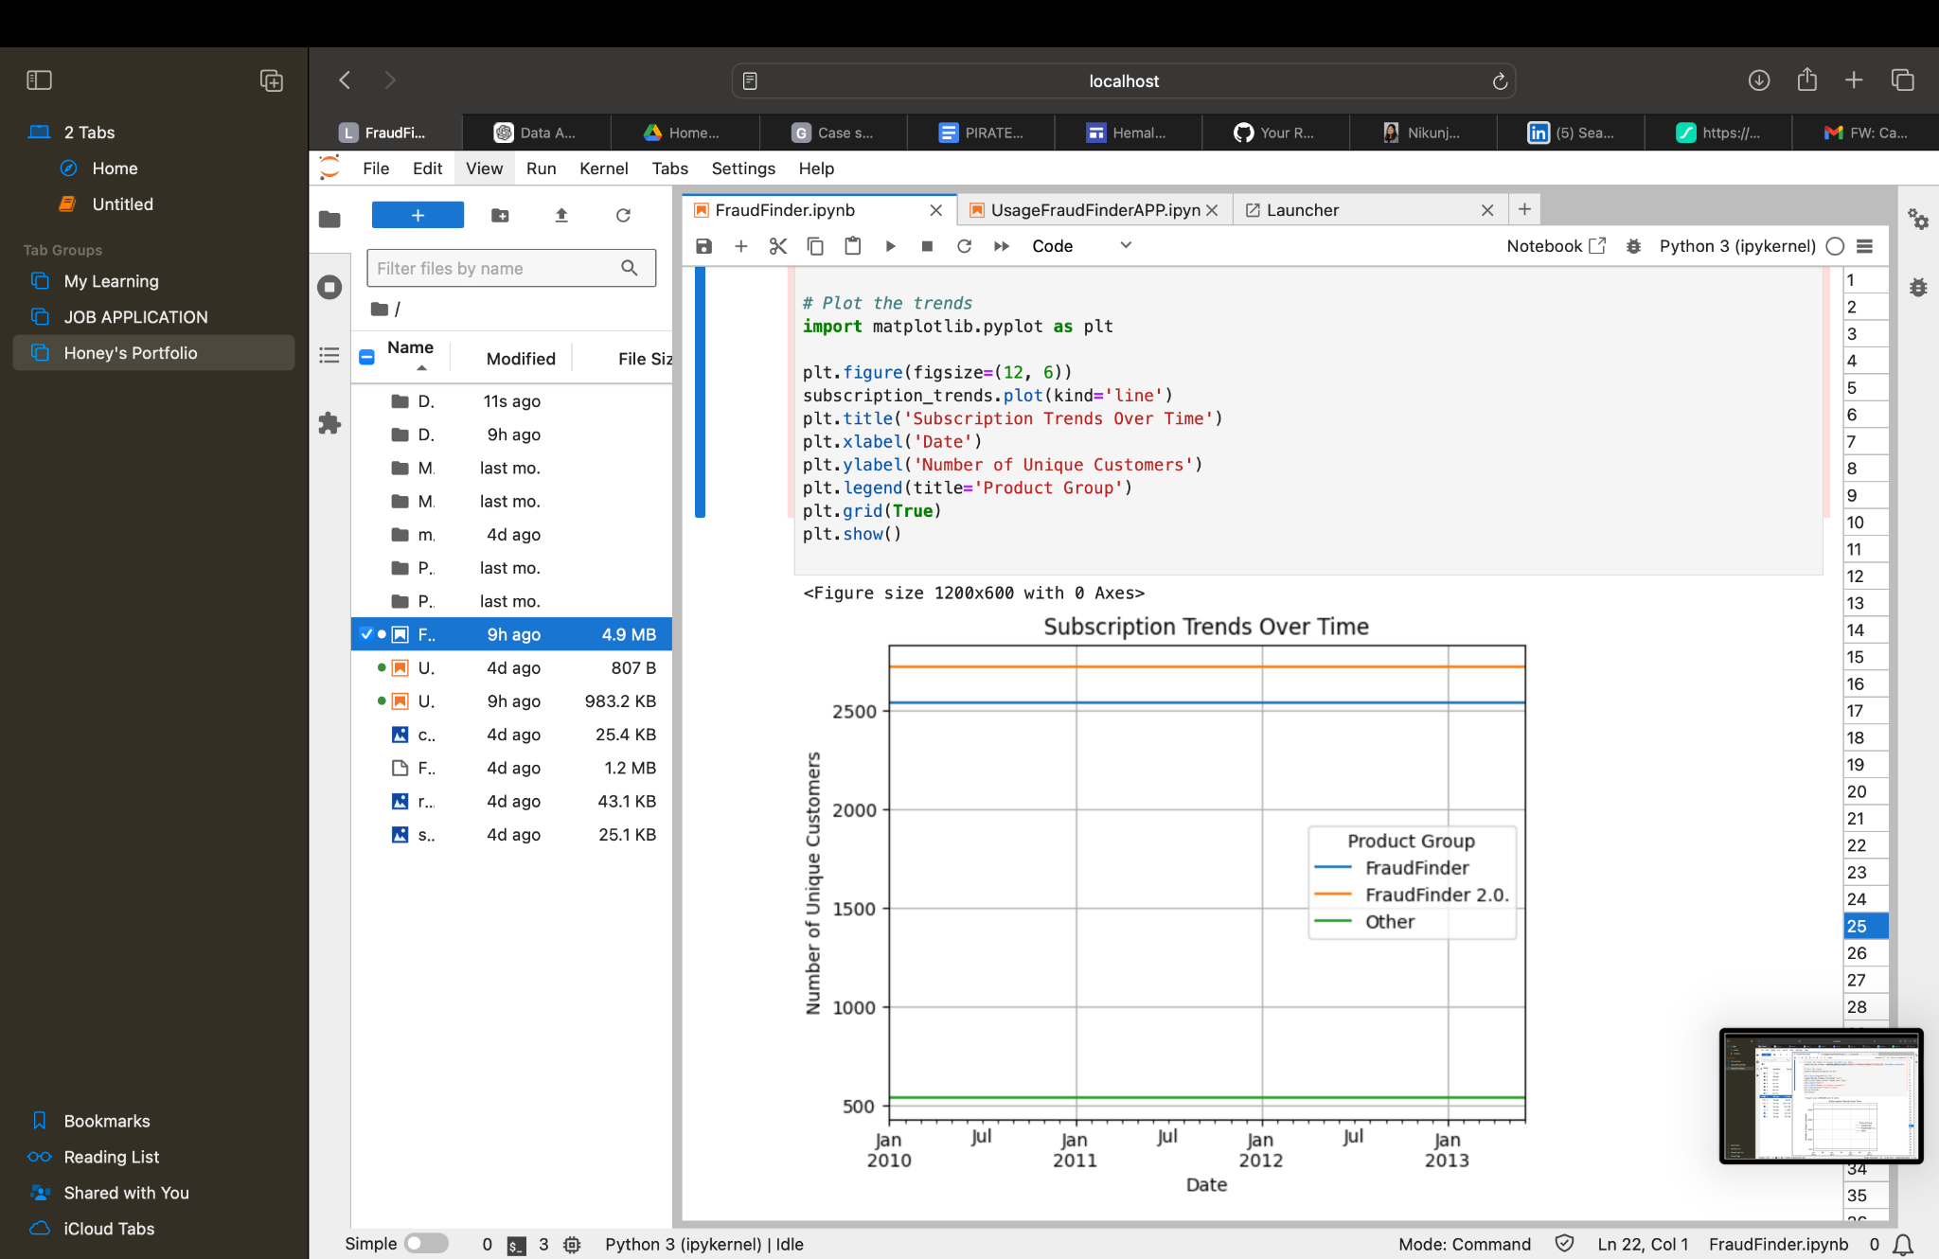
Subscription Trends Over Time :
Notes:
This chart shows the number of subscriptions for both FraudFinder and FraudFinder 2.0 over the past few years, indicating customer migration trends.

Slide 5
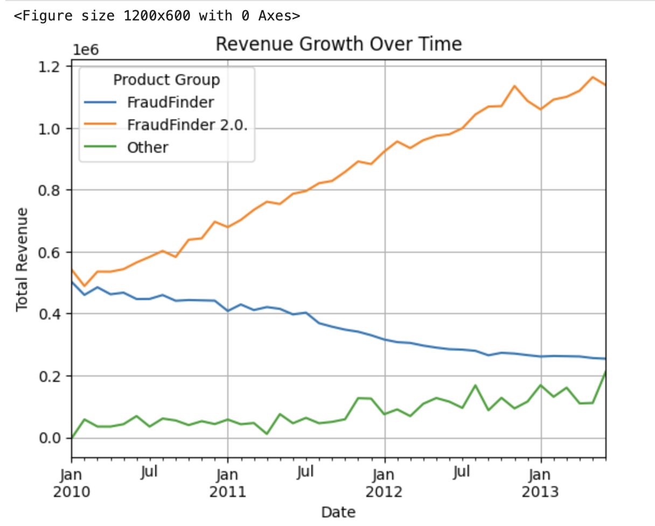
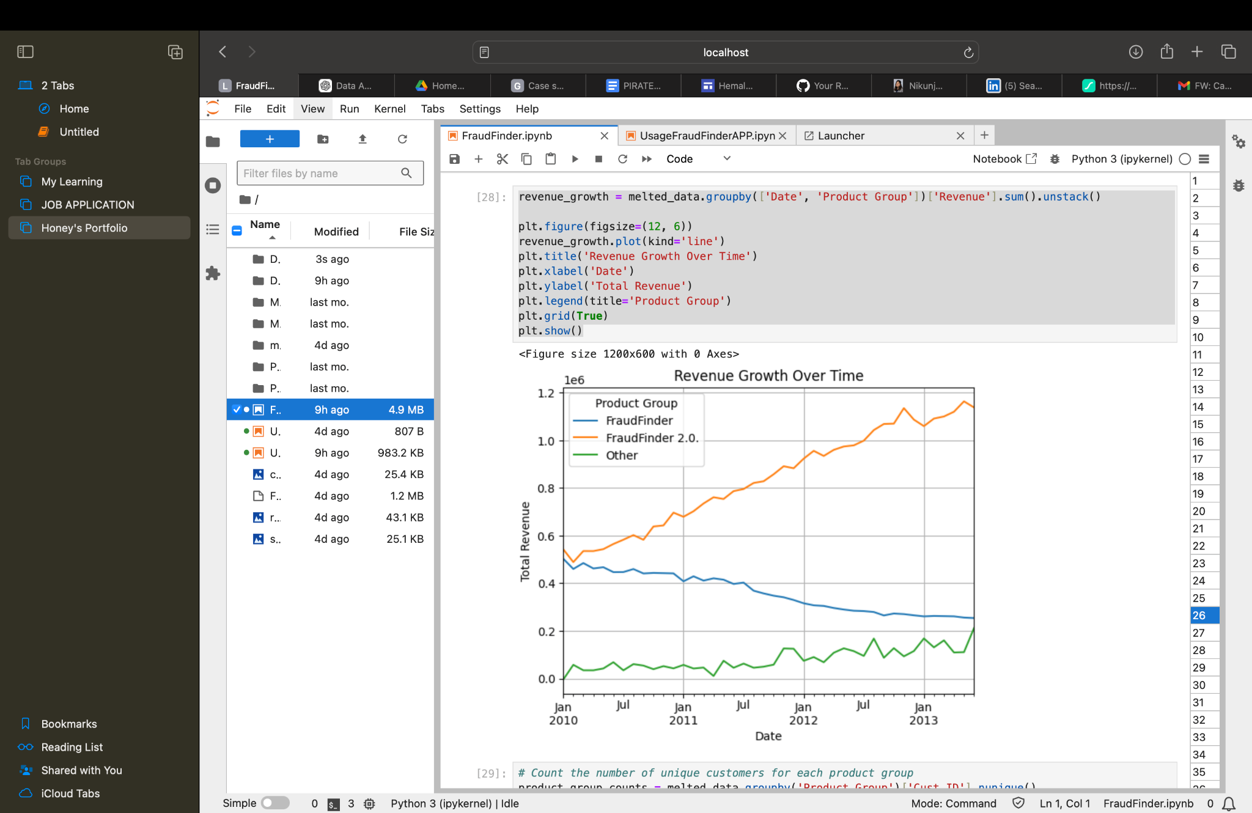
Revenue Growth Over Time :
Notes:
This chart illustrates the revenue growth driven by the annual 10% price increase policy over the last three years.

Slide 6
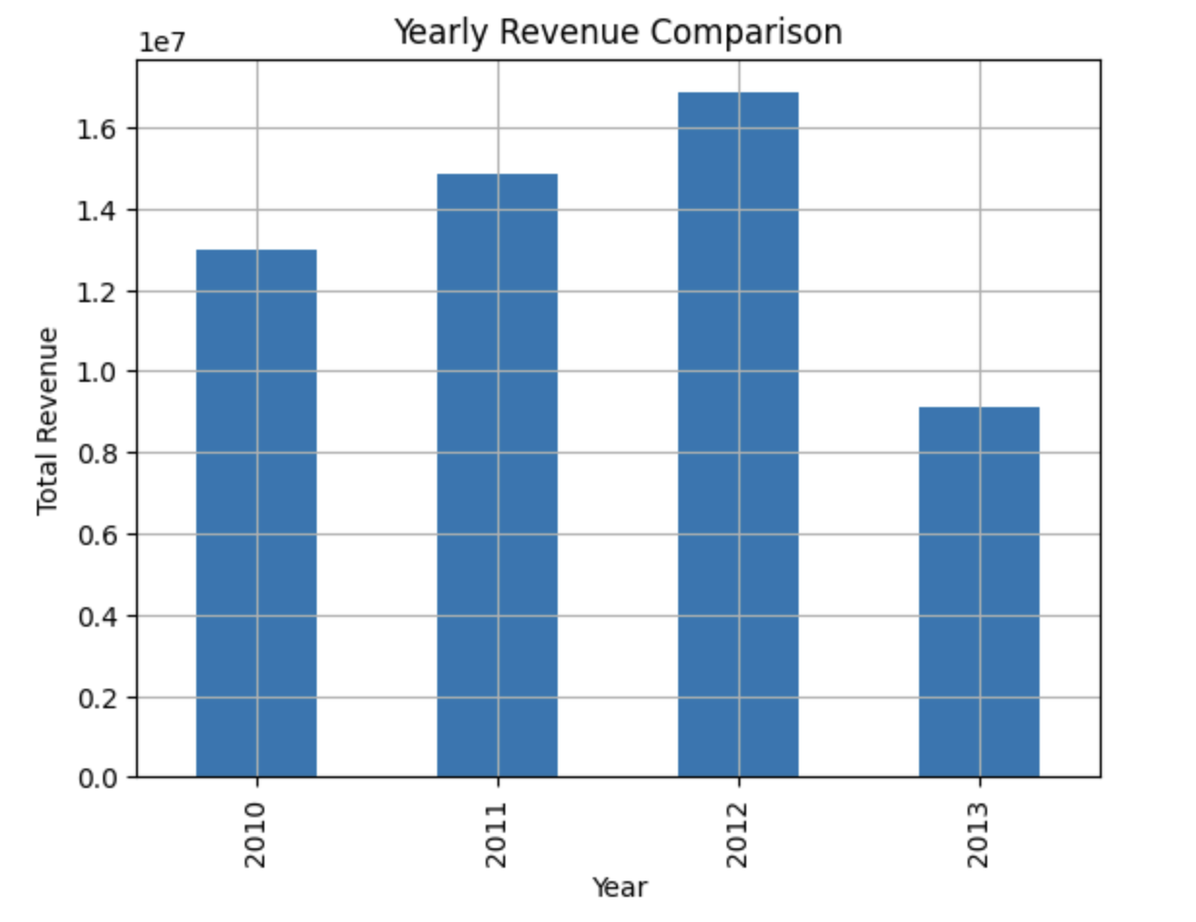
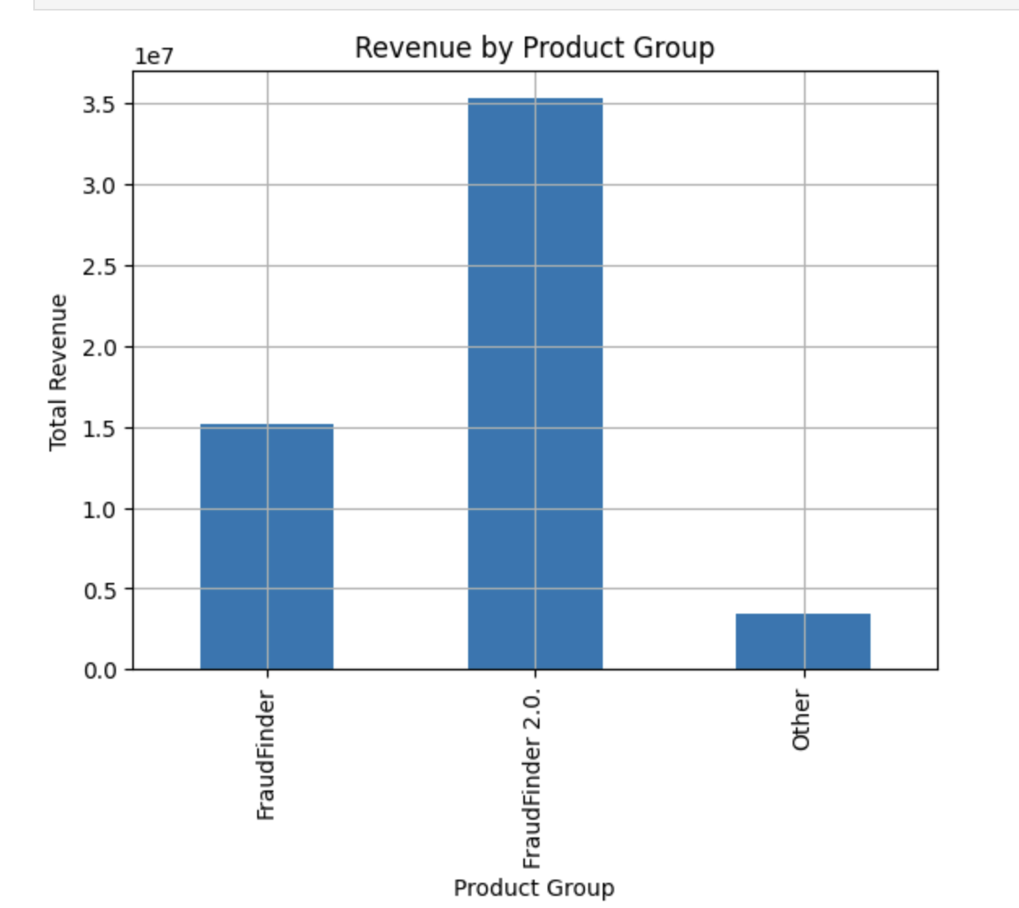
Revenue Growth Comparison :
Revenue by Product Group
Notes:
This chart shows the number of subscriptions for both FraudFinder and FraudFinder 2.0 over the past few years, indicating customer migration trends.

Slide 7
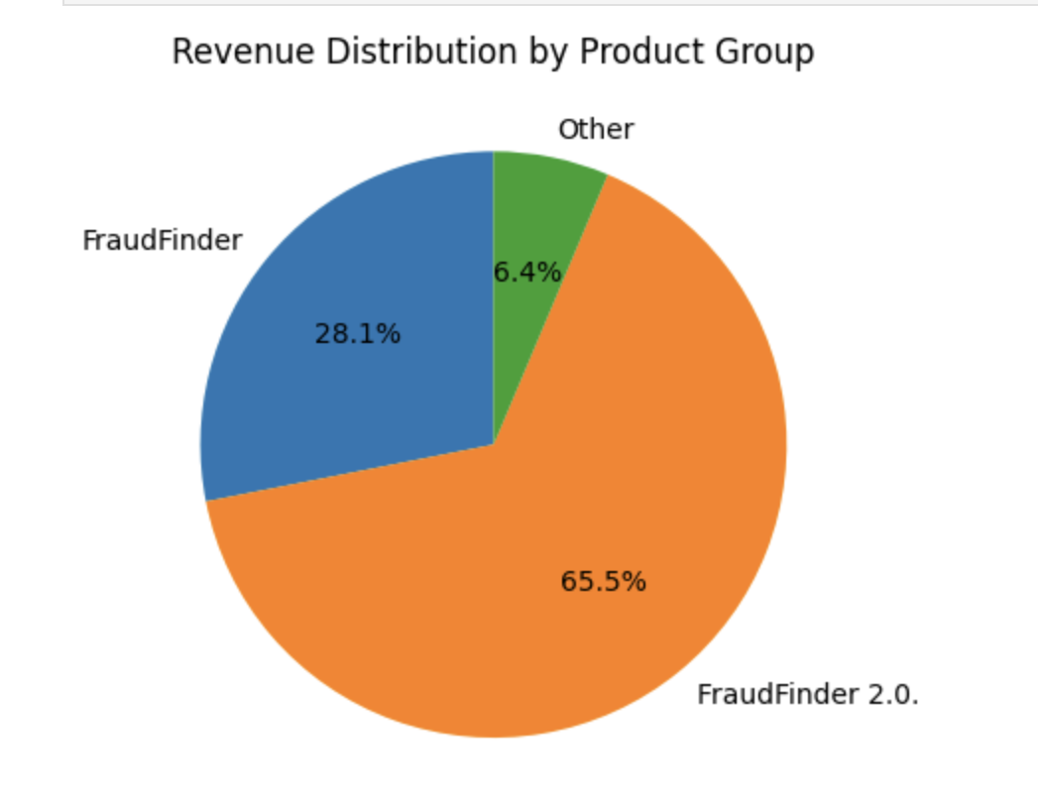
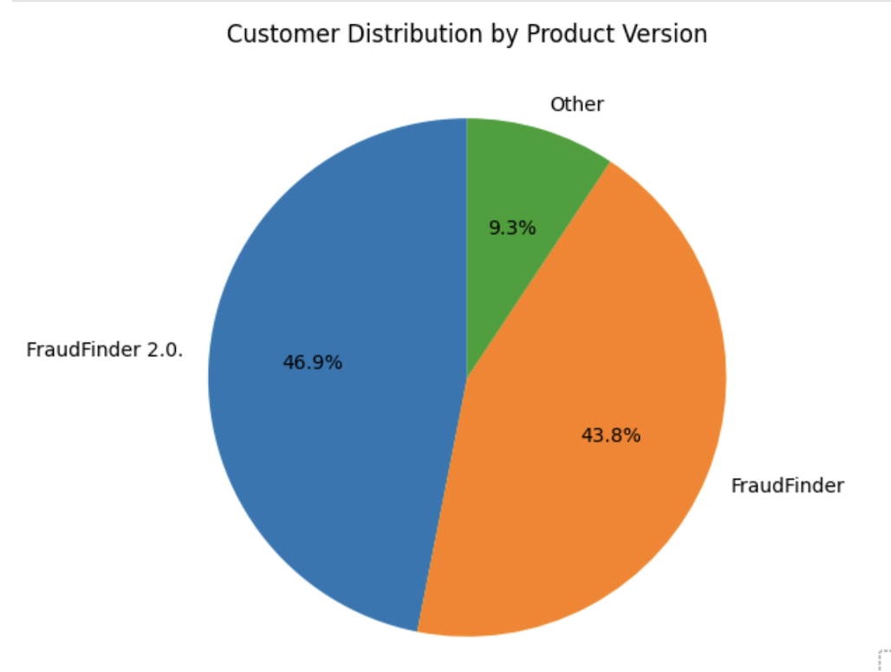
Customer & Revenue Distribution by Product :

Slide 8
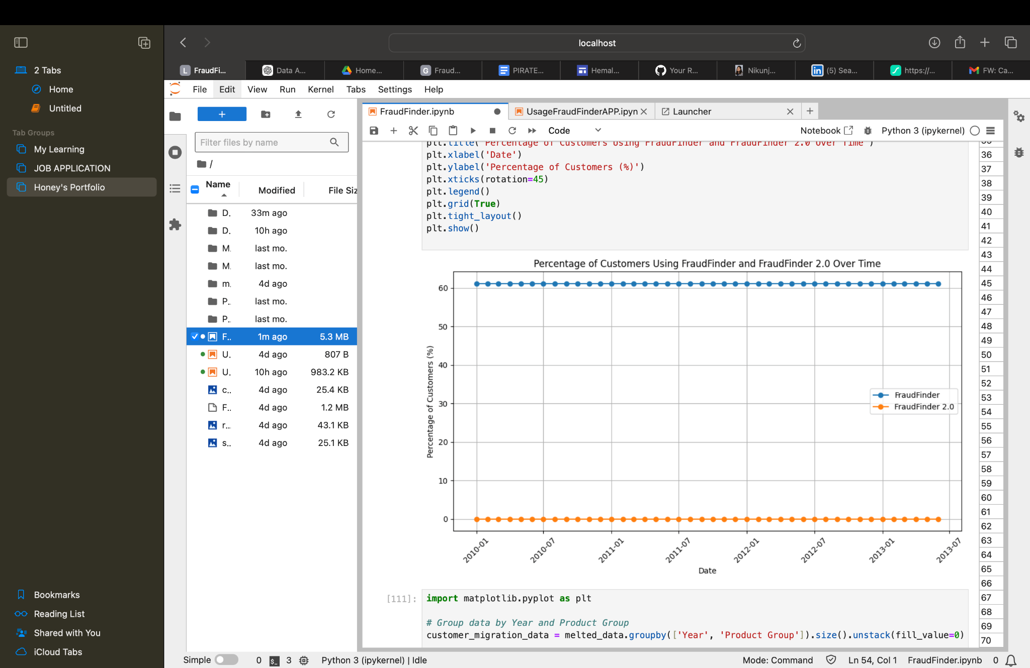
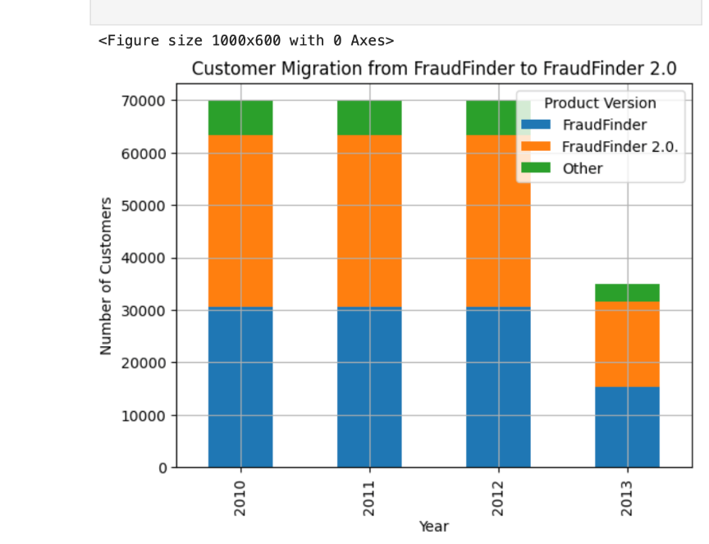
Customer Retention & Acquisition :
Notes:
This graph compares retention rates for customers using FraudFinder and FraudFinder 2.0 over time.

Slide 9
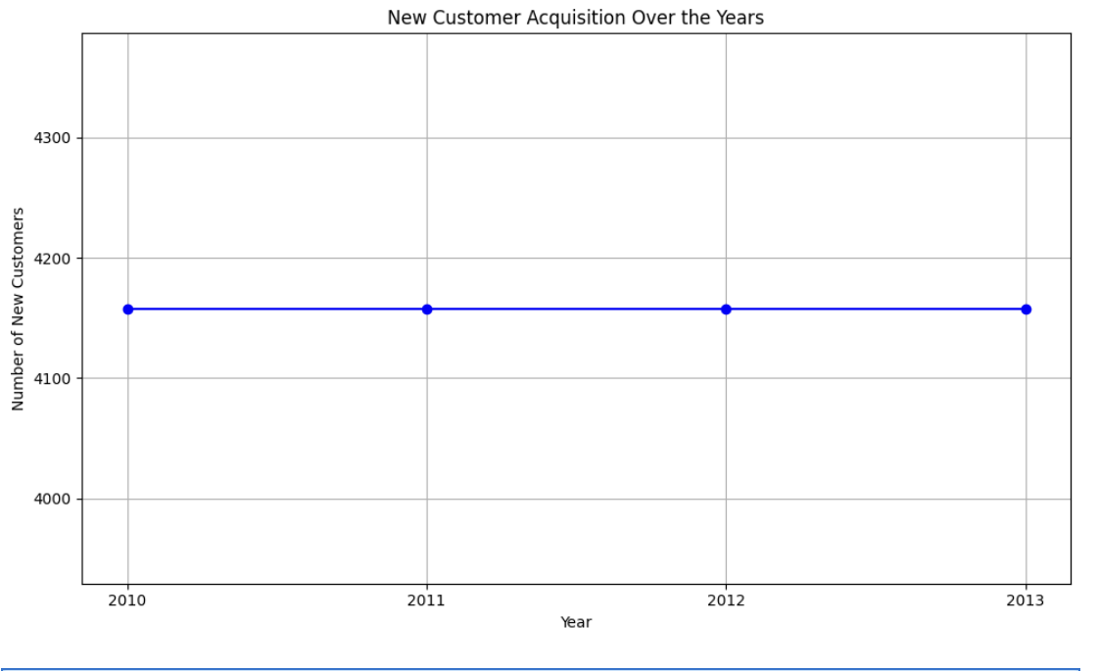
New Customer Acquisition :

Slide 10
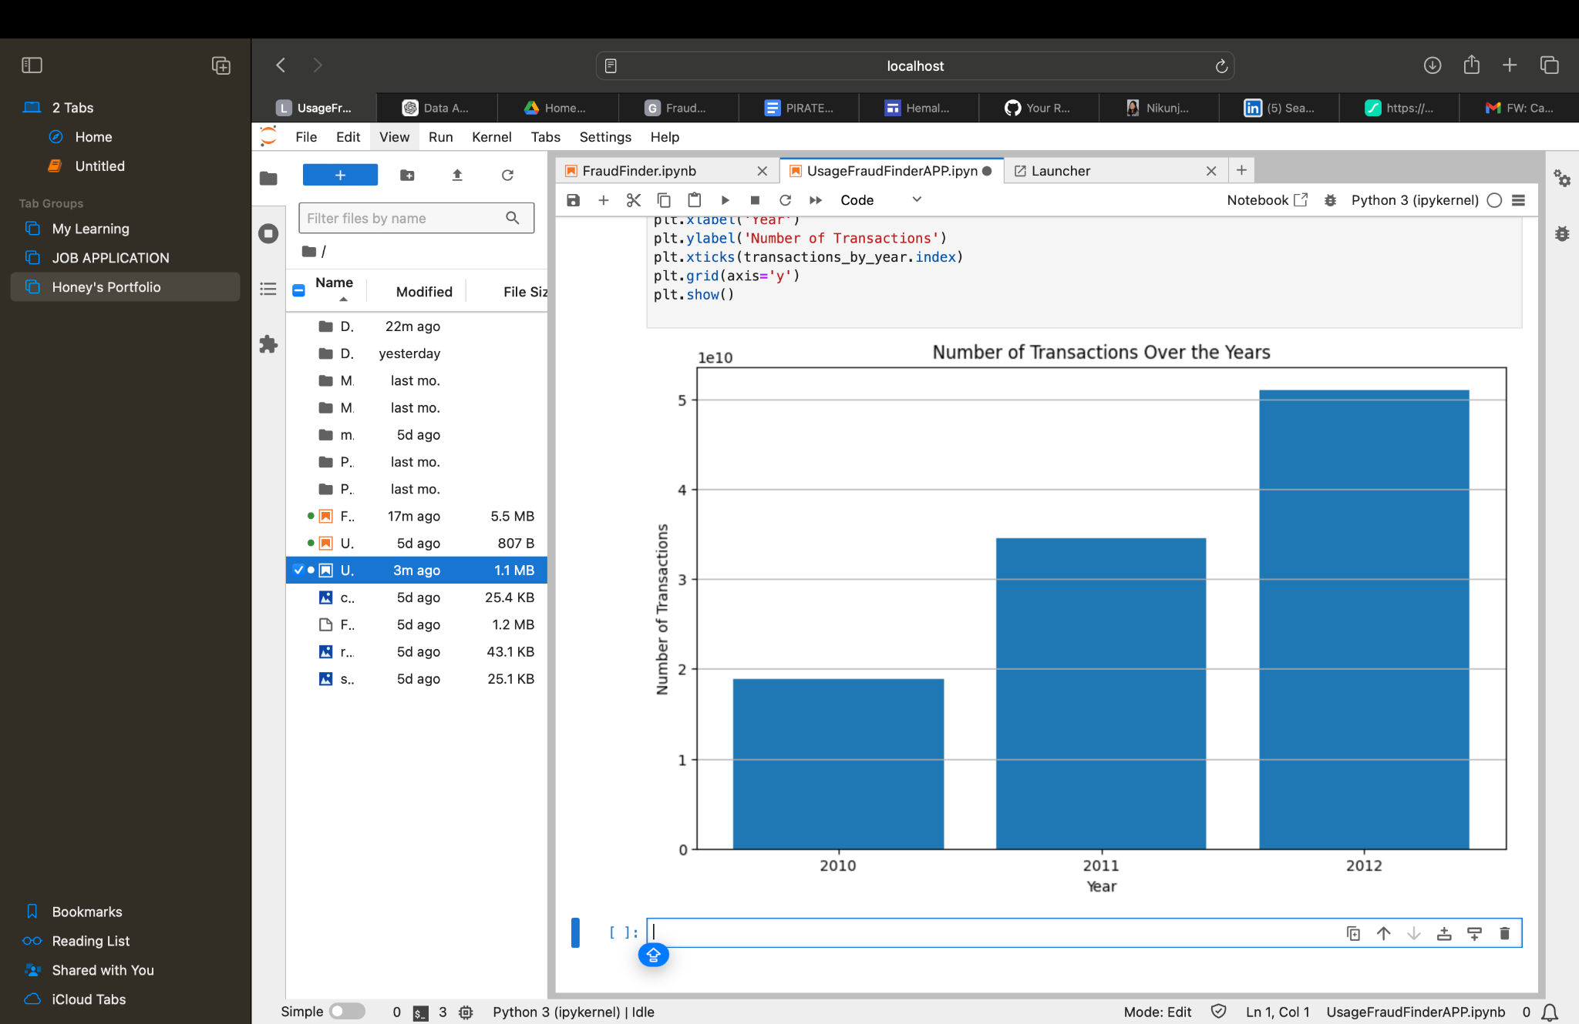
Number of Transaction Over the Years :
Notes:
The bar chart illustrates the total number of transactions over the years, revealing a noticeable increase in usage from 2010 to 2012, with 2012 exhibiting the highest transaction volume, suggesting a growing trend in customer engagement and activity over time.

Slide 11
RESULTS

Slide 12
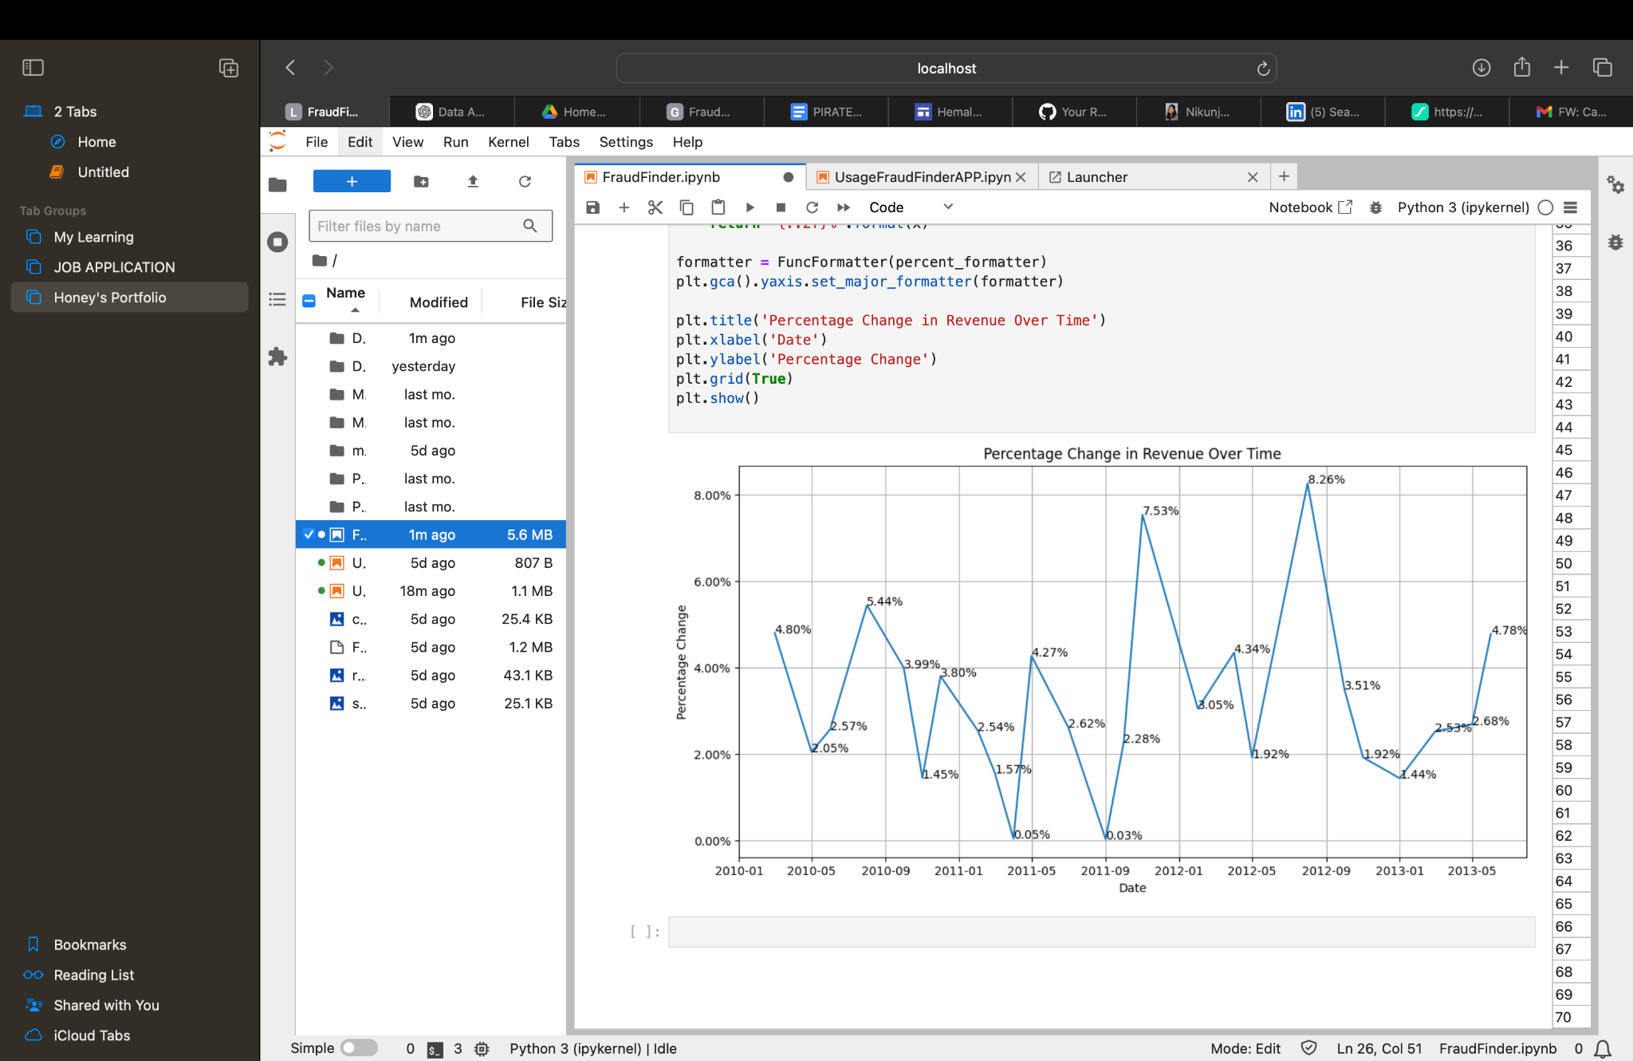
% Change in Revenue Over time:

Slide 13
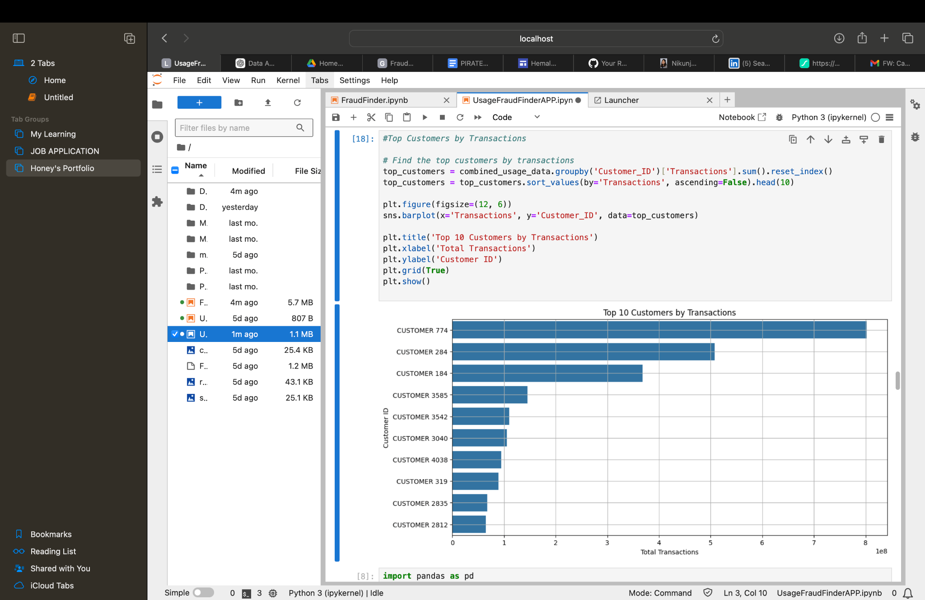
Top 10 Customers by Transaction :

Slide 14
Models :
Three models selected for evaluation : Linear Regression, Random Forest, and Support Vector Machine (SVM).
The performance of each model was evaluated using RMSE as the metric. The RMSE values obtained were as follows:
Linear Regression RMSE: 692.97
Random Forest RMSE: 594.56 [ Better Model ]
Support Vector Machine RMSE: 768.41
Notes:
Lower RMSE values indicate better performance, so the Random Forest model seems to be performing better than the Linear Regression model in this case. You can further fine-tune the Random Forest model or try other machine learning algorithms to see if you can improve the prediction performance even further.
In this case, the features are 'Transactions', 'Product Group', and 'Year'.
It represents the values you want to predict based on the features. The target variable is typically denoted as 'y'.

Slide 15
In 2012, the revenue further increased to approximately $16.84 million, showing a continued positive trend with an increase of about $1.97 million from 2011.
There are more than 60% of customers who are still using FraudFinder.
FRAUD FINDER
FRAUD
FINDER 2.0
Revenue Growth
Customer Acquisition
There are more than 2900k unique customers who subscribed to fraudfinder 2.0 over time.
Customer acquisition remained steady from 2010 to 2013, with around 4158 new customers acquired each year, showcasing consistent product interest and engagement.

Slide 16
Recommendations :
Investment in Customer Service: Enhance customer service initiatives to address any issues or concerns identified through the analysis, thereby improving customer satisfaction and loyalty.
Expansion into New Markets: Explore opportunities for expansion into new geographic markets or customer segments based on insights into revenue distribution and customer behavior.
Improve Product Offerings: Continuously innovate product offerings based on customer feedback and market trends to meet evolving preferences and stay ahead of competitors.
Investment in Technology: Invest in technology infrastructure and tools to streamline data collection, analysis, and decision-making processes, enabling faster and more accurate insights.

Slide 17
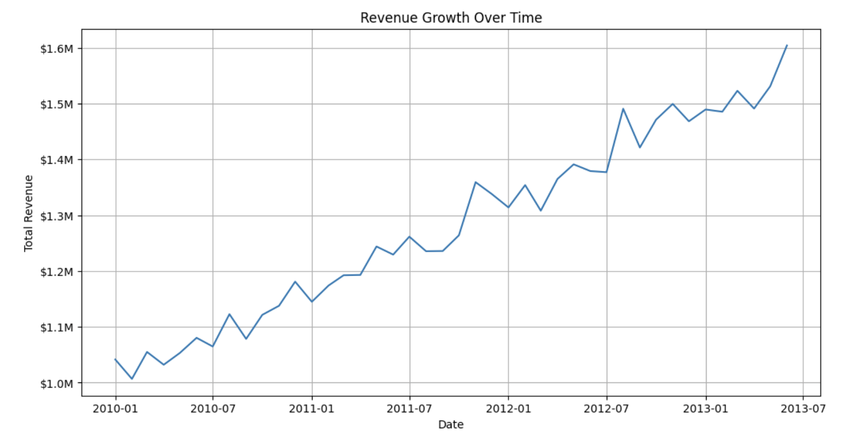
Impact
max growth
Over the last six months, there has been a notable increase of approximately 13.33% in revenue.

Slide 18
References
Github Code:
https://github.com/Honey-Dandwani/FraudFinder-Case-Study/tree/main

Slide 19
Thank you.

